Slide 1
Layering in Networked computing
OSI Model
TCP/IP Model
Protocols at each layer

Slide 2
Learning outcomes
Understand the need of layering in Networked computing
Understand the OSI model and the tcp/ip model
  Understand the function protocols and their role at each layer.
    TCP protocol
    UDP protocol
Understand the role of header in communication between layers
Understand how data sent from one host arrive to the target host.

Slide 3
What is layering in Networked computing?
  Breaks down communication into smaller, simpler parts.

Slide 4
Why a layered model?
  Easier to teach communication process.
  Speeds development, changes in one layer does not affect how the other levels works.
  Standardization across manufactures.
  Allows different hardware and software to work together.
  Reduces complexity

Slide 5
The OSI Reference Model
OSI

Slide 6
The OSI Model
OSI “ Open Systems Interconnection".
OSI model was first introduced in 1984 by the International Organisation for Standardisation (ISO).
  Outlines WHAT needs to be done to send data from one computer to another.
  Not HOW it should be done.
  Protocols stacks handle how data is prepared for transmittal (to be transmitted)
In the OSI model, The specification needed
  are contained in 7 different layers that interact with each other.

Slide 7
What is “THE MODEL?”
Commonly referred to as the OSI reference model.
The OSI model
  is a theoretical blueprint that helps us understand how data gets from one user’s computer to another.
  It is also a model that helps develop standards so that all of our hardware and software talks nicely to each other.
  It aids standardization of networking technologies by providing an organized structure for hardware and software developers to follow, to insure there products are compatible with current and future technologies.

Slide 8
7 Layer OSI Model
Why use a reference model?
  Serves as an outline of rules for how protocols can be used to allow communication between computers.
  Each layer has its own function and provides support to other layers.
Other reference models are in use.
  Most well known is the TCP/IP reference model.
  We will compare OSI and TCP/IP models
As computing requirements increased, the network modeling had to evolve to meet ever increasing demands of larger networks and multiple venders.
Problems and technology advances also added to the demands for changes in network modeling.

Slide 9
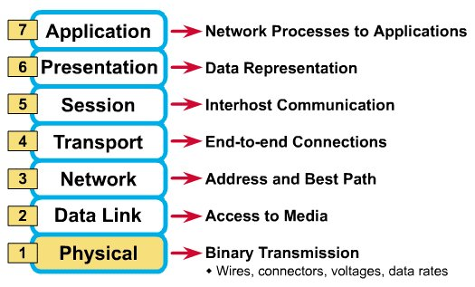
What Each Layer Does
²

Slide 10
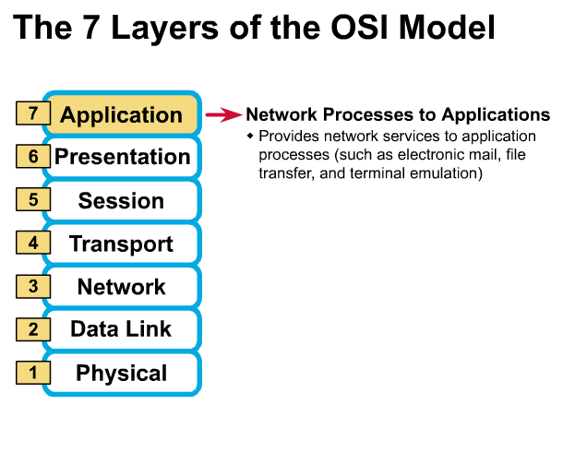
Gives end-user applications access to network resources
Where is it on my computer?
  Workstation or Server Service in MS Windows
³

Slide 11
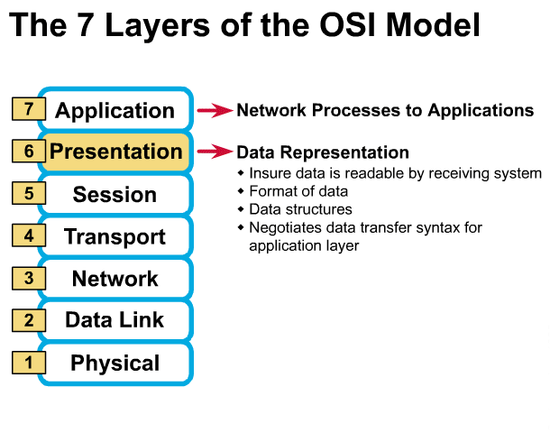
Presentation Layer
³

Slide 12
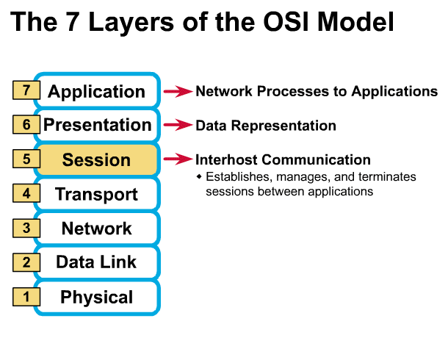
Session Layer
Allows applications to maintain an ongoing session
Where is it on my computer?
  Workstation and Server Service (MS)
  Windows Client for NetWare (NetWare)
³

Slide 13
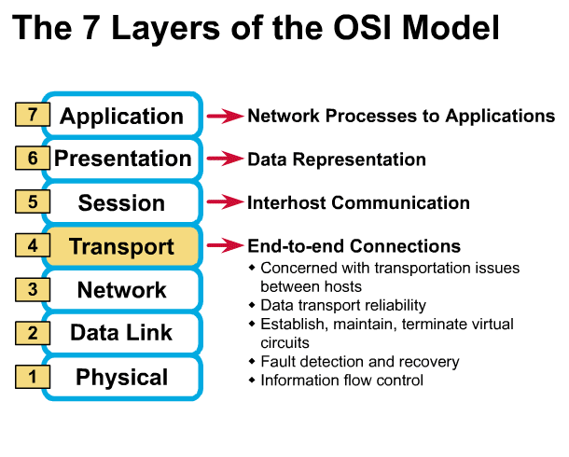
Transport Layer
Provides reliable data delivery
It’s the TCP in TCP/IP
Receives info from upper layers and segments it into packets
Can provide error detection and correction
³

Slide 14
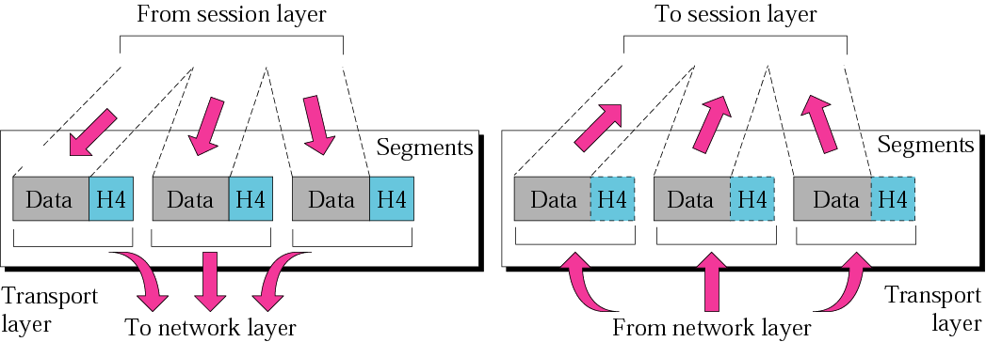
Figure 2.9 Transport layer
The transport layer is responsible for the delivery of a message from one process to another.

Slide 15
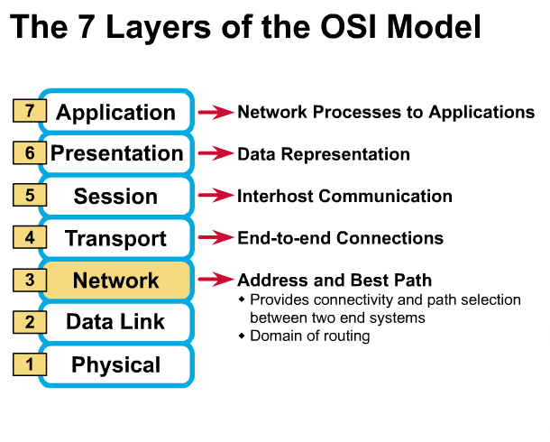
Network Layer
Provides network-wide addressing and a mechanism to move packets between networks (routing)
Responsibilities:
  Network addressing
  Routing
Example:
  IP from TCP/IP
³

Slide 16
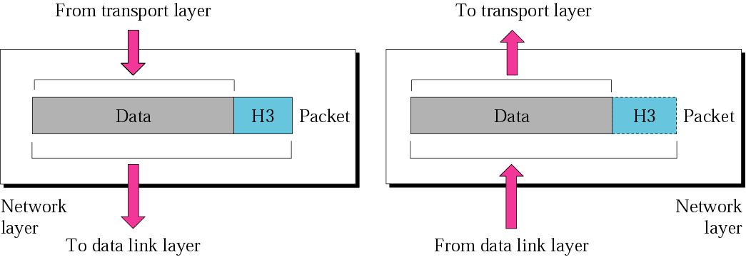
Network layer
The network layer is responsible for the delivery of individual packets from the source host to the destination host.

Slide 17
Network Addresses
Network-wide addresses
Used to transfer data across subnets
Used by routers for packet forwarding
Example:
  IP Address
Where is it on my computer?
  TCP/IP Software

Slide 18
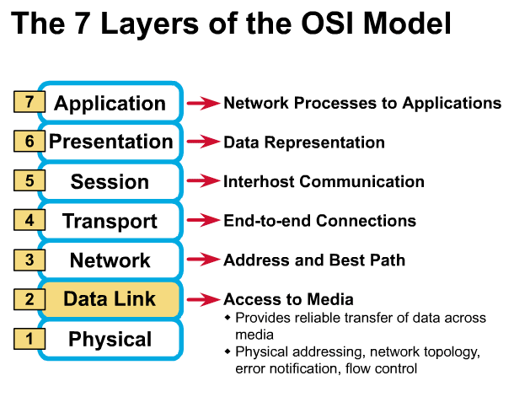
Data Link Layer
Places data and retrieves it from the physical layer and provides error detection capabilities
³

Slide 19
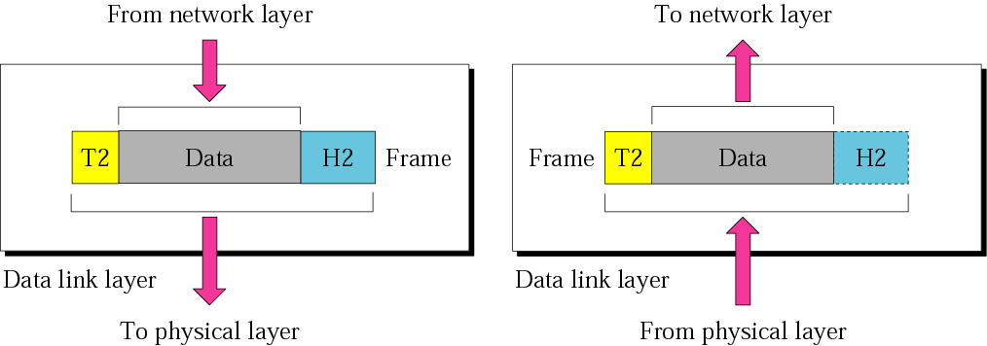
Data link layer
The data link layer is responsible for moving frames from one hop (node) to the next.

Slide 20
Sub-layers of the Data Link Layer
MAC (Media Access Control)
  Gives data to the NIC
  Controls access to the media through:
    CSMA/CD Carrier Sense Multiple Access/Collision Detection
    Token passing
LLC (Logical Link Layer)
  Manages the data link interface (or Service Access Points (SAPs))
  Can detect some transmission errors using a Cyclic Redundancy Check (CRC). If the packet is bad the LLC will request the sender to resend that particular packet.

Slide 21
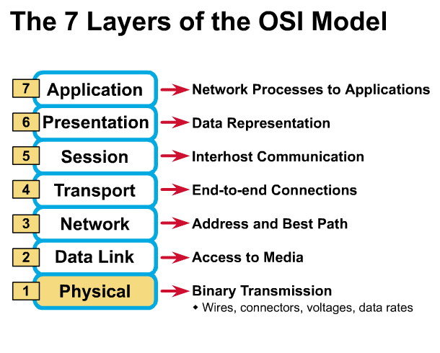
Physical Layer
Determines the specs for all physical components
  Cabling
  Interconnect methods (topology / devices)
  Data encoding (bits to waves)
  Electrical properties
Examples:
  Ethernet (IEEE 802.3)
  Token Ring (IEEE 802.5)
  Wireless (IEEE 802.11b)
³

Slide 22
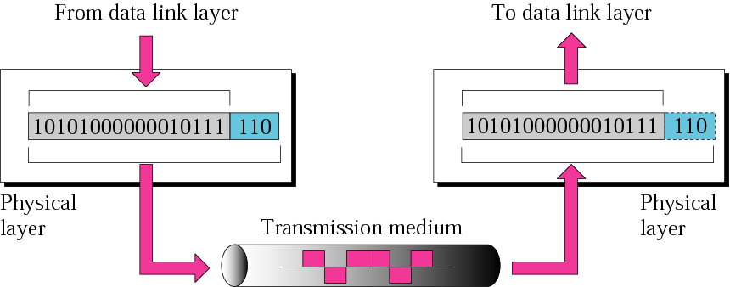
Physical layer
The physical layer is responsible
for the movement of individual bits from one hop (node) to the next.

Slide 23
Physical Layer (cont’d)
What are the Physical Layer components on my computer?
NIC
  Network Interface Card
  Has a unique 12 character Hexadecimal number permanently burned into it at the manufacturer.
  The number is the MAC Address/Physical address of a computer
Cabling
  Twister Pair
  Fiber Optic
  Coax Cable

Slide 24
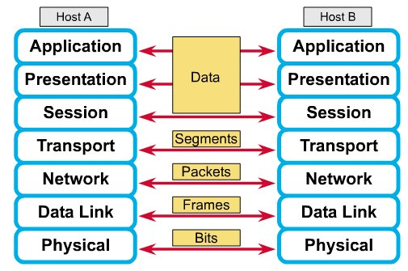
How Does It All Work Together
Each layer contains a Protocol Data Unit (PDU)
  PDU’s are used for peer-to-peer contact between corresponding layers.
  Data is handled by the top three layers, then Segmented by the Transport layer.
  The Network layer places it into packets and the Data Link frames the packets for transmission.
  Physical layer converts it to bits and sends it out over the media.
  The receiving computer reverses the process using the information contained in the PDU.
²

Slide 25
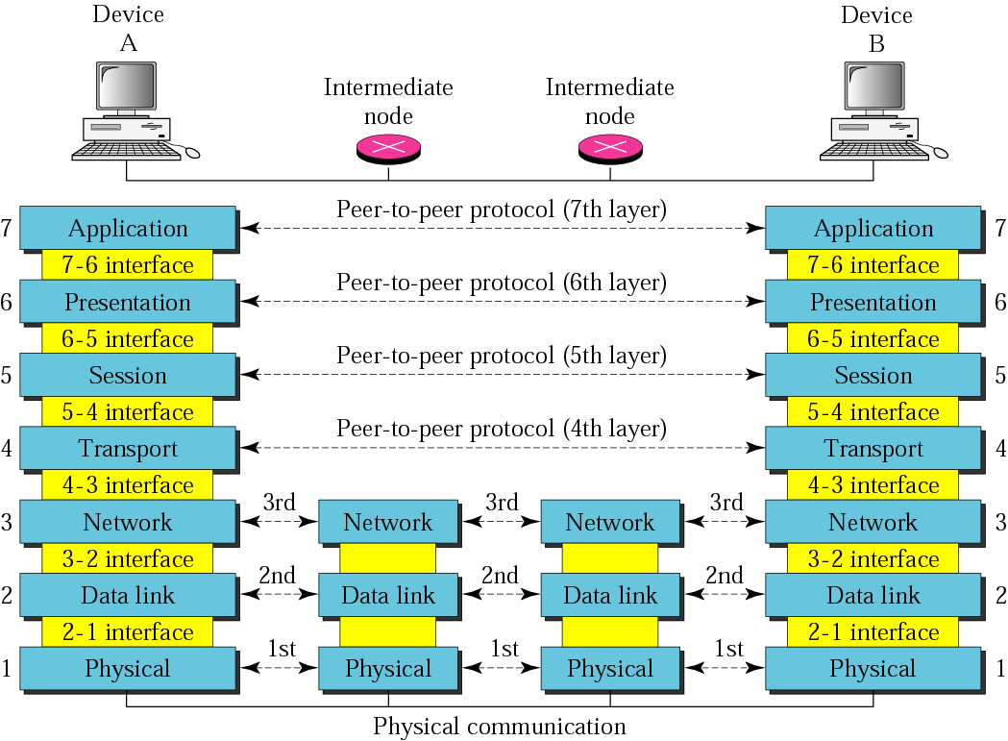
Figure 2.2 OSI layers

Slide 26
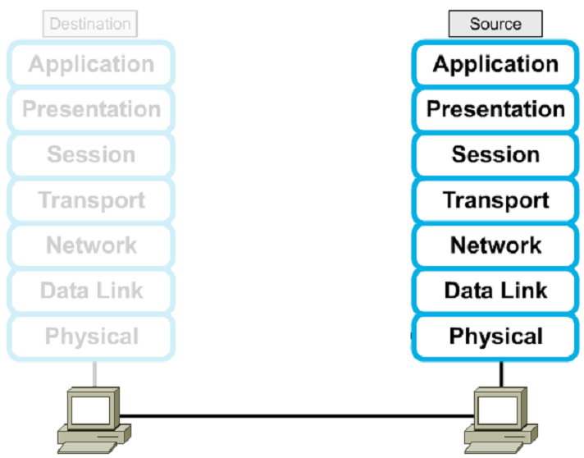




Encapsulation

Slide 27
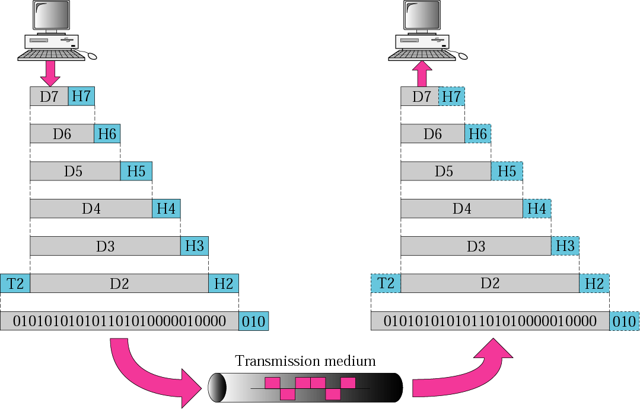
Figure 2.3 An exchange using the OSI model

Slide 28
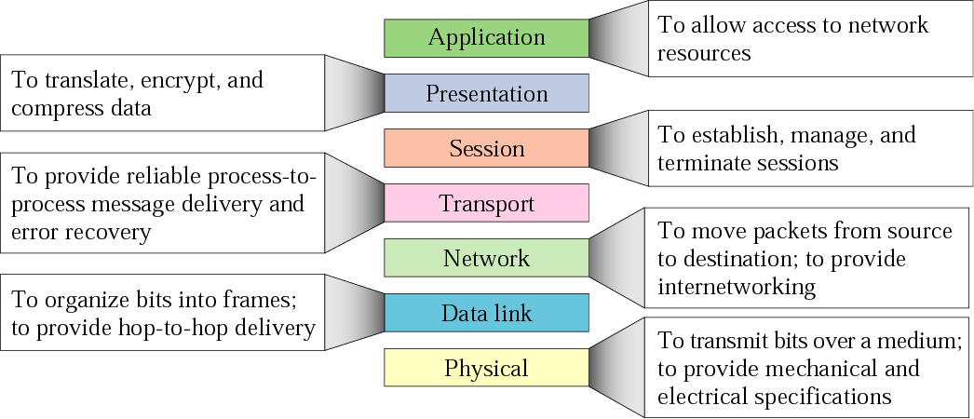
Figure 2.14 Summary of layers

Slide 29
The Postal Analogy
How would the OSI compare to the regular Post Office
Application
A- Write a 20 page letter to a foreign country.
P- Translate the letter so the receiver can read it.
S- Insure the intended recipient can receive letter.
T- Separate and number pages. Like registered mail, tracks delivery and requests another package if one is “lost” or “damaged” in the mail.
N- Postal Center sorting letters by zip code to route them closer to destination.
D- Local Post Office determining which vehicles to deliver letters.
P- Physical Trucks, Planes, Rail, autos, etc which carry letter between stations.
Presentation
Session
Transport
Network
Data-Link
Physical

Slide 30
Remembering the 7 Layers
7 - Application All
6 - Presentation People
5 - Session Seem
4 - Transport To
3 - Network Need
2 - Data Link Data
1 - Physical Processing

Slide 31
Student Activity:
Tutorial 4
Give 3 reasons why is the OSI model needed in the field of computer networking?
Which standards organisation published the OSI model in 1983?
How many layers are in the OSI model?
For each layer of the OSI model state the layer name and 2 tasks associated with each layer
Which layer is responsible for the transmission of the data bits from the sender to the receiver?
Which layer is responsible for fault detection and recovery?
Which layer is responsible for routing of the data?
Which layer is responsible for dealing with IP addresses?
Which layer is responsible for dealing with MAC addresses?

Slide 32
TCP/IP model development
The late-60s The Defense Advance Research Projects Agency (DARPA) originally developed Transmission Control Protocol/Internet Protocol (TCP/IP) to interconnect various defense department computer networks.
The Internet, an International Wide Area Network, uses TCP/IP to connect networks across the world.

Slide 33
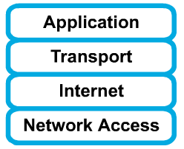
4 layers of the TCP/IP model
Layer 4: Application
Layer 3: Transport
Layer 2: Internet
Layer 1: Network access
It is important to note that some of the layers in the TCP/IP model have the same name as layers in the OSI model.
Do not confuse the layers of the two models.

Slide 34
The network access layer
Concerned with all of the issues that an IP packet requires to actually make the physical link. All the details in the OSI physical and data link layers.
  Electrical, mechanical, procedural and functional specifications.
  Data rate, Distances, Physical connector.
  Frames, physical addressing.
  Synchronization, flow control, error control.

Slide 35
The internet layer
Send source packets from any network on the internetwork and have them arrive at the destination independent of the path and networks they took to get there.
  Packets, Logical addressing.
  Internet Protocol (IP).
  Route , routing table, routing protocol.

Slide 36
The transport layer
The transport layer deals with the quality-of-service issues of reliability, flow control, and error correction.
  Segments, data stream, datagram.
  Connection oriented and connectionless.
  Transmission control protocol (TCP).
  User datagram protocol (UDP).
  End-to-end flow control.
  Error detection and recovery.

Slide 37
TCP/IP Reference Model (cont)
3. Transport layer (layer 3)
  Allows end-to-end communication
  Connection establishment, error control, flow control
  Two main protocols at this level
    Transmission control protocol (TCP),
      Connection oriented
        Connection established before sending data
        Reliable
    user datagram protocol (UDP)
      Connectionless
        Sending data without establishing connection
        Fast but unreliable

Slide 38
The application layer
Handles high-level protocols, issues of representation, encoding, and dialog control.
The TCP/IP combines all application-related issues into one layer, and assures this data is properly packaged for the next layer.
  FTP, HTTP, SMNP, DNS ...
  Format of data, data structure, encode …
  Dialog control, session management …

Slide 39
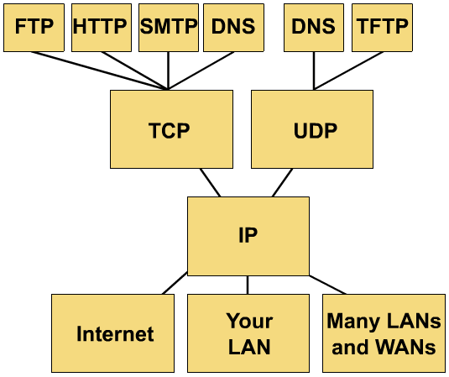
TCP/IP protocol stack

Slide 40
TCP/IP Reference Model
Layer
Protocols
Application
HTTP
TELNET
FTP
SMTP
SNMP
Transport
TCP
UDP
Internet
IP
ICMP
Network Access
(Host-to-network)
ETHERNET
PACKET RADIO

Slide 41
Protocols at the application layer
HTTP:
  browser and web server communicatin
FTP :
  file transfer protocol
TELNET:
  remote login protocol
POP3: Retrieve email
  POP3 is designed to delete mail on the server as soon as the user has downloaded it
IMAP (Internet Message Access Protocol )
  Retrieve emails,
  retaining e-mail on the server and for organizing it in folders on the serve

Slide 42
Protocols at the transport layer
    Transmission control protocol (TCP),
      Connection oriented
        Connection established before sending data
        Reliable
    user datagram protocol (UDP)
      Connectionless
        Sending data without establishing connection
        Fast but unreliable

Slide 43
Protocol at the network layer
IP
  Path selection ,
  routing and addressing
ICMP (Internet Control Message Protocol )
  sends error messages relying on IP
    a requested service is not available
    a host or router could not be reached

Slide 44
Protocols at the link layer
Ethernet
  Uses CSMA/CD
Token Ring

Slide 45
Data Encapsulation In TCP/IP
At each layer in the TCP/IP protocol stack
    Outgoing data is packaged and identified for delivery to the layer underneath
PDU – Packet Data Unit – the “envelop” information attached to a packet at a particular TCP/IP protocol
    e.g. header and trailer
Header
    PDU’s own particular opening component
    Identifies the protocol in use, the sender and intended recipient
Trailer (or packet trailer)
  Provides data integrity checks for the payload

Slide 46
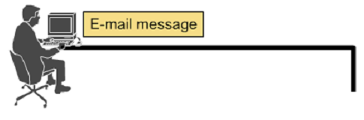




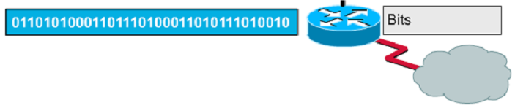
Encapsulation example: E-mail

Slide 47
Data Formats
Application data
message
application
layer
transport
layer
TCP
header
data
TCP
header
data
TCP
header
data
segment
network
layer
IP
header
TCP
header
data
packet
data link
layer
Ethernet
header
IP
header
TCP
header
data
Ethernet
trailer
frame

Slide 48
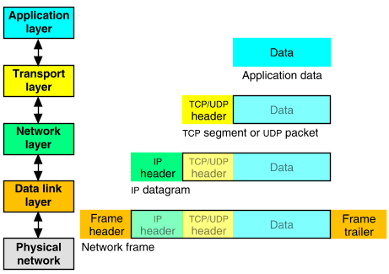
Packet Encapsulation (TCP/IP)
The data is sent down the protocol stack
Each layer adds to the data by prepending headers
22Bytes
20Bytes
20Bytes
4Bytes
64 to 1500 Bytes

Slide 49
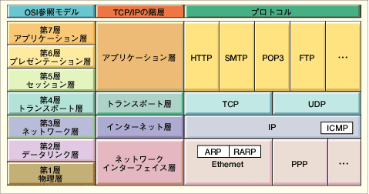
Comparing TCP/IP with OSI
OSI Model
TCP/IP Hierarchy
Protocols
7th
Application Layer
6th
Presentation Layer
Application Layer
5th
Session Layer
4th
Transport Layer
Transport Layer
3rd
Network Layer
Internet Layer
2nd
Link Layer
Network Access Layer
1st
Physical Layer
Link Layer : includes device driver and network interface card
Network Layer : handles the movement of packets, i.e. Routing
Transport Layer : provides a reliable flow of data between two hosts
Application Layer : handles the details of the particular application

Slide 50
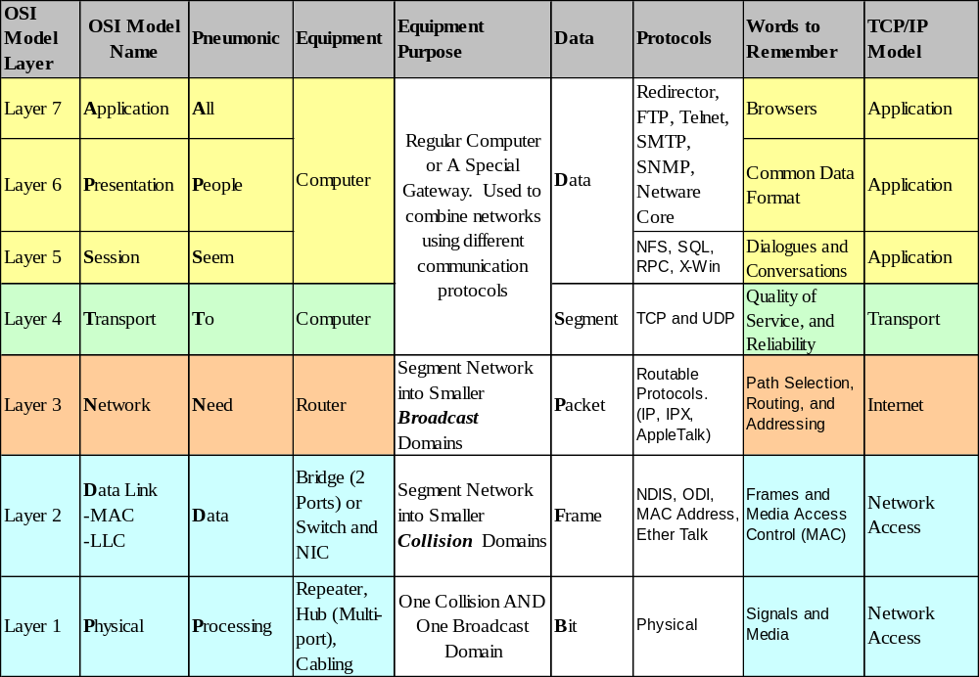
How the OSI and TCP/IP Models Relate in a Networking Environment

Slide 51
Student Activity
Which layer information is used by a Router?
Which layer information is used by a Switch?
Which layer is used by a Hub?
Which layer does the TCP protocol operate at?
Which layer does the IP protocol operate at?
What is a PDU?
What is meant by data encapsulation?
What is the PDU at the Transport layer?
What is the PDU at the Network layer?
How many layers are in the TCP/IP protocol model?
Show with a diagram how the OSI and TCP/IP models compare
At what level of the OSI model does the HTTP protocol work?
At what level of the TCP/IP model does the UDP protocol work?
When the PDU is a packet state what the corresponding layers are for the OSI and the TCP/IP models
When data formatting is considered state what the corresponding layers are for the OSI and the TCP/IP models

Slide 52
Internet applications
TCP/IP takes care of the hard problems
  Location of the destination host
  Making sure the data is received in the correct order and error free
Coding Internet applications
  Turns out to be straightforward.
The key concept of Internet programming is
  The client-server model

Slide 53
Client-Server model
Client and server processes operate on machines which are able to communicate through a network:
  The Server waits for requests from client
  When a request is received
  The server lookup for the requested data
  And send a response the client
Sockets and ports
  A socket is and end-point of way communication link between two programs
  A port number bound to a socket specifies the protocol need the be used at the receiving end
Example of servers
  File servers
  Web servers
Example of client applications
  Browsers
  Email clients

Slide 54
What is a socket?
An interface between application and network.
  Create a socket
    Socket(Protocolfamily, type-of-communicatio, specific- protocol);
  The application creates a socket
  The socket type dictates the style of communication
    reliable vs. best effort
    connection-oriented vs. connectionless

Slide 55

Port 0
Port 1
Ports
Port 65535
Each host has 65,536 ports
  20,21: FTP
  23: Telnet
  80: HTTP
A socket provides an interface to send data to/from the network through a port

Slide 56
Protocols
For a great graphic of protocol stacks in relationship to the OSI model, visit http://www.lex-con.com/osimodel.htm
For more information on the OSI model, including an animated graphic and various protocol information, visit http://www.certyourself.com/OSIguide.shtml

Slide 57
Reading
http://www.howtheosimodelworks.com , Charles C. Botsford, 2001.
https://cisconetacad.net, Cisco Academy Connection Editors, 2002.
http://www.hawkclan.com/zxonly/iso/slide2.html
http://www.pku.edu.cn/academic/research/computer-center/tc/html/TC0102.html, William L. Whipple &
Sharla Riead, 1997.
http://www.lex-con.com/protocols/ip.htm, Lexicon Computing, Dallas TX, 2002

